Slide 1

Patient Survival Prediction
By Alicia qu

Slide 2
PROBLEM
Current prediction on patient death is very pool

Slide 3
GOAL
Improve patient outcomes, improve patient care, reduce costs, and optimize resource utilization by increase prediction efficiency

Slide 4
OUTCOME
Build a prediction model, the model improved the predictive power more than 10 times.
A more reliable prediction and by analyzing result of the feature importance allow clients to develop reasonable personalized treatments on patients.

Slide 5

DATA WRAGLING
Dropped some useless columns
Identified outlier threshold and dropped outlier
Dropped rows that have more than 20% missing values
Left the rest missing values for now to avoid data leakage
Cut rows from 91713 to 84026
Reduced features from 85 to 82
Data Source:
https://www.kaggle.com/datasets/mitishaagarwal/patient/data

Slide 6
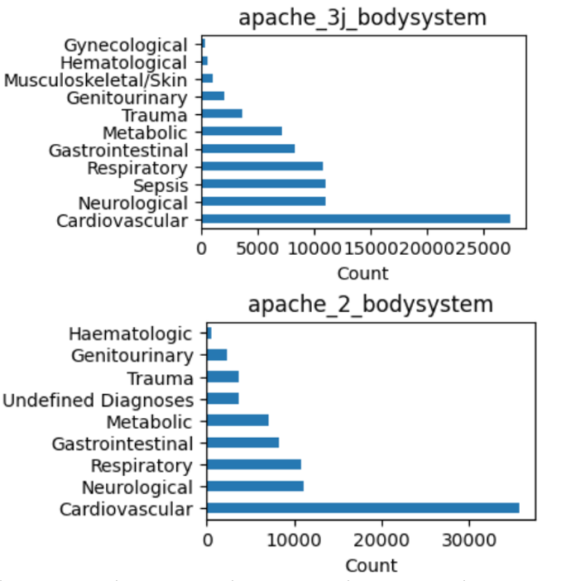
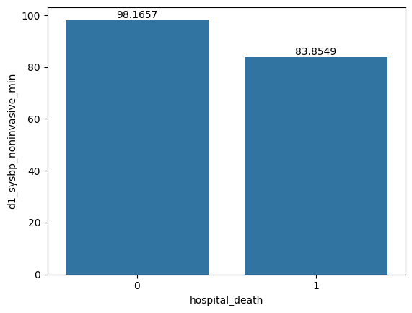
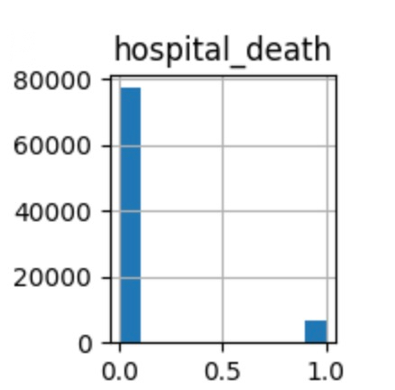
EXPLORATORY DATA ANALYSIS

Slide 7
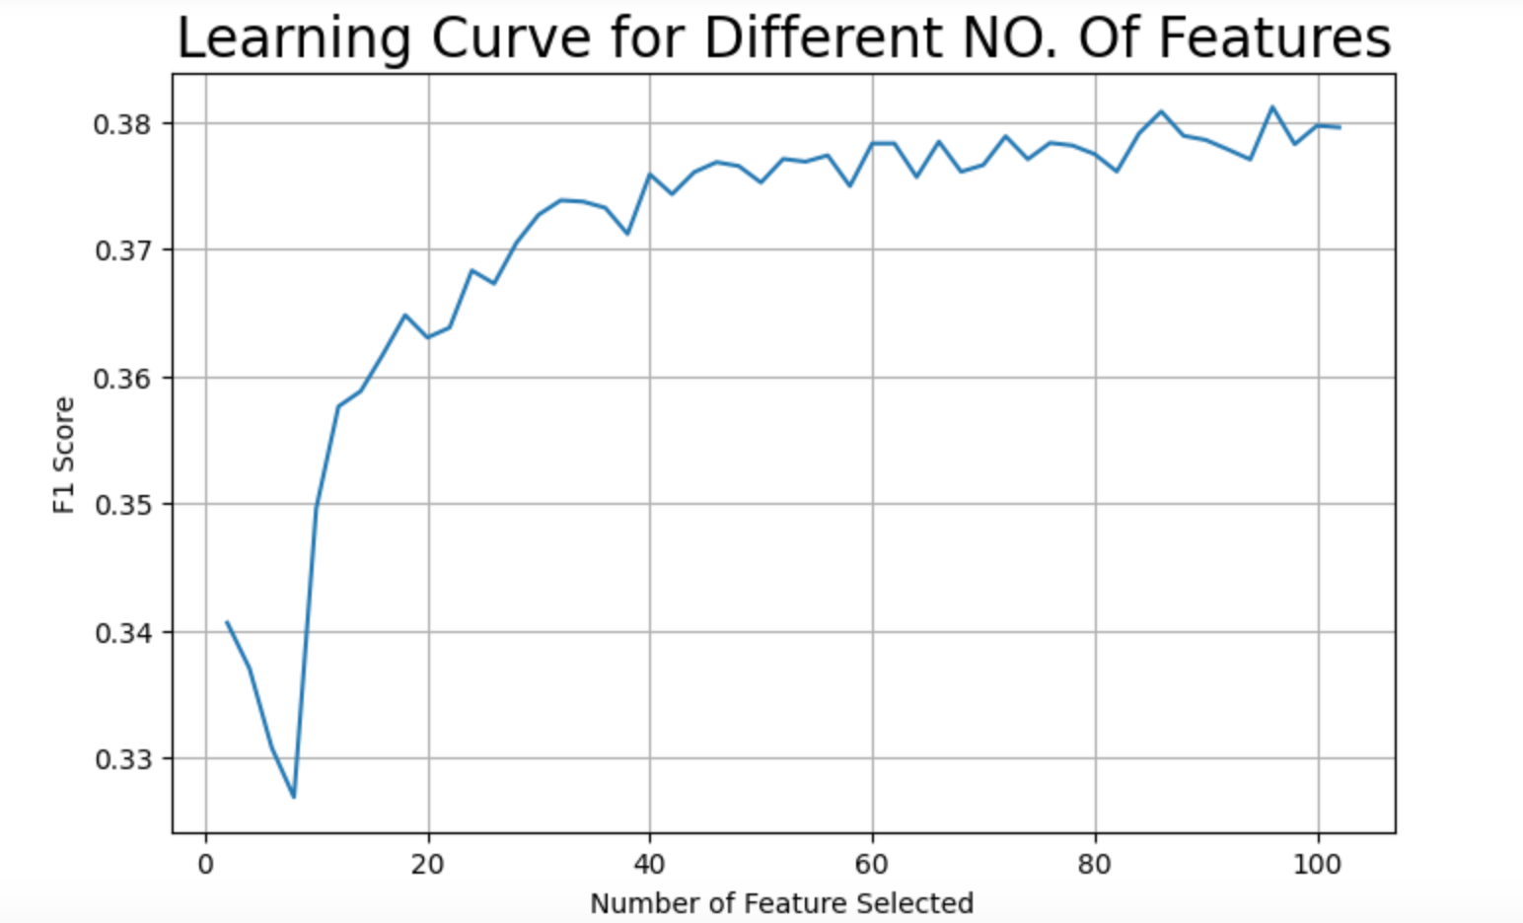
FEATURE SELECTION
MODELING
Logistic Regression
Bernoulli Naïve Bayes
Random Forest
XGBoost
Balanced Random Forest
Balanced Bagging

Slide 8
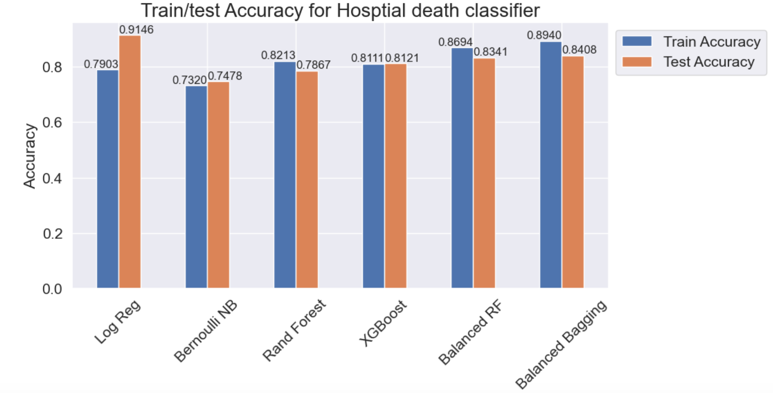
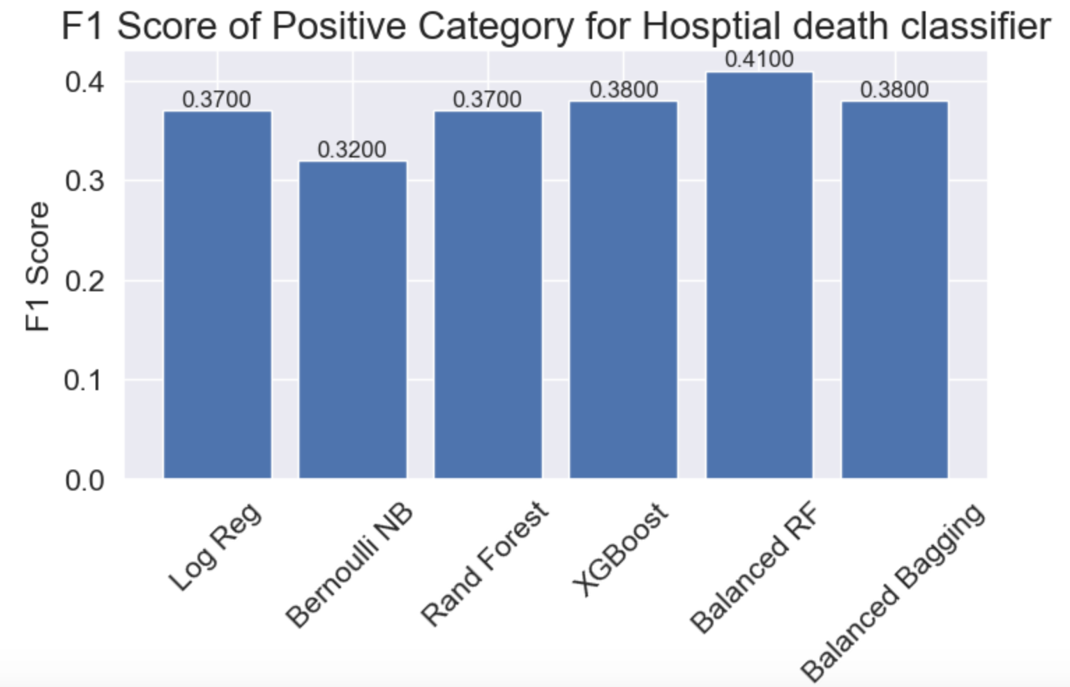
MODEL SELECTION
Accuracy & F1 Score

Slide 9
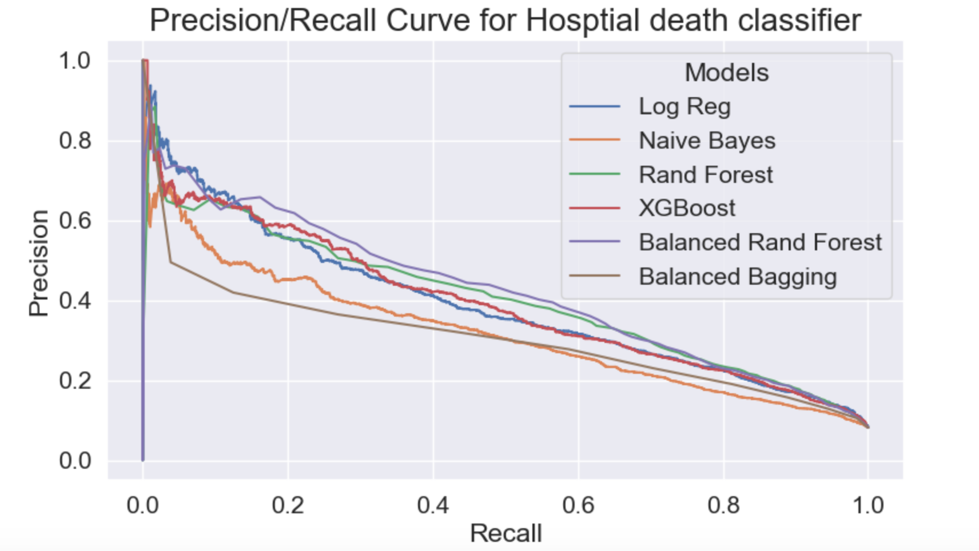
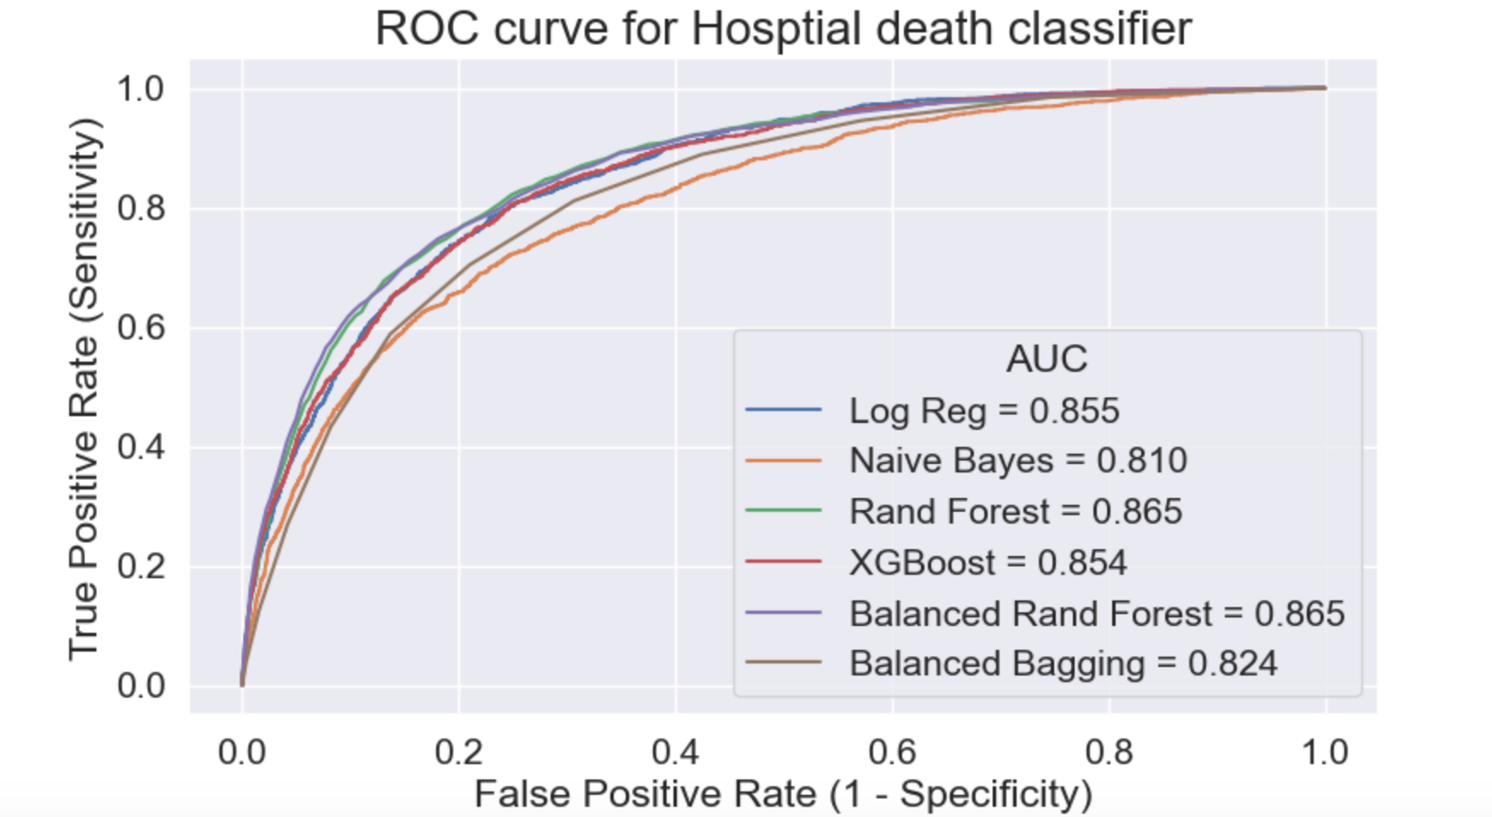
MODEL SELECTION
Precision/Recall Curve & ROC/AUC

Slide 10
MODEL SELECTION
Hyperparameter tuning & Final Model
Final Model: Random Forest
Parameters & Hyperparameters:
criterion | entropy
max_depth | 90
max_features | log2
min_samples_leaf | 3
min_samples_split | 3
n_estimators | 122
sampling_strategy | 0.299692895
random_state | 12
performance metrics
Train Accuracy: | 0.9534
Test Accuracy: | 0.9095
Train MAE: | 0.0466
Test MAE: | 0.0905
Mean Cross-Validation f1 Score: | 0.4656
f1_macro | 0.7100
AUC Score | 0.8683

Slide 11
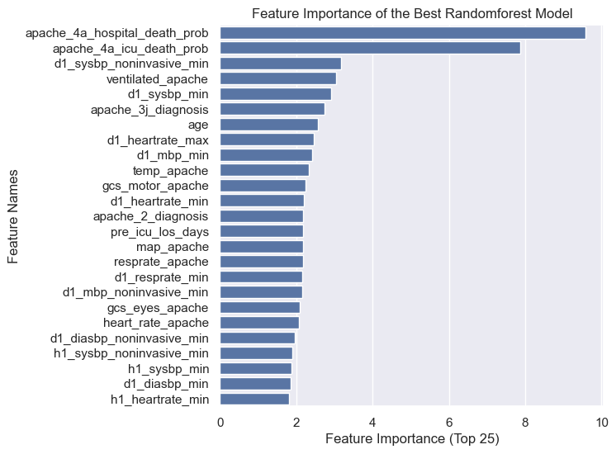
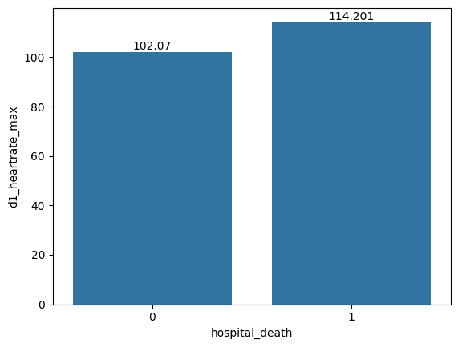
MODEL EVALUATION
ventilated_apache Value | Death Rate
0 | 3.98%
1 | 16.74%

Slide 12
TAKEAWAYS
The best model improves the predictive power on patient death more than 10 times
Apache scores are critical metrics
Clients can make more reasonable decision and develop personalized treatments on patients
Consider a situation:
A 65 years old man and a 35 years old man both need to use ventilation machine, but there is only one ventilation machine. How can our model help the healthcare provider make decision?

Slide 13
FUTURE RESEARCH
Collect more data to make the target more balanced
Follow up with new metrics besides apache scores

Slide 14

THANK YOU! & QUESTIONS?

